Slide 1
Looking for the keys.. (even where the light isn’t there)
Jitendra Malik
UC Berkeley
Facebook AI Research

Slide 2
Embodied Cognition
Vision
(broadly,perception)
Motor Control
(broadly,planning)
Language
Semantic Reasoning

Slide 3
What has been responsible for recent AI successes?
Big Computing
Big Data

Slide 4
What has been responsible for recent AI successes?
Big Computing
Big Data
Big Annotation
Big Simulation

Slide 5
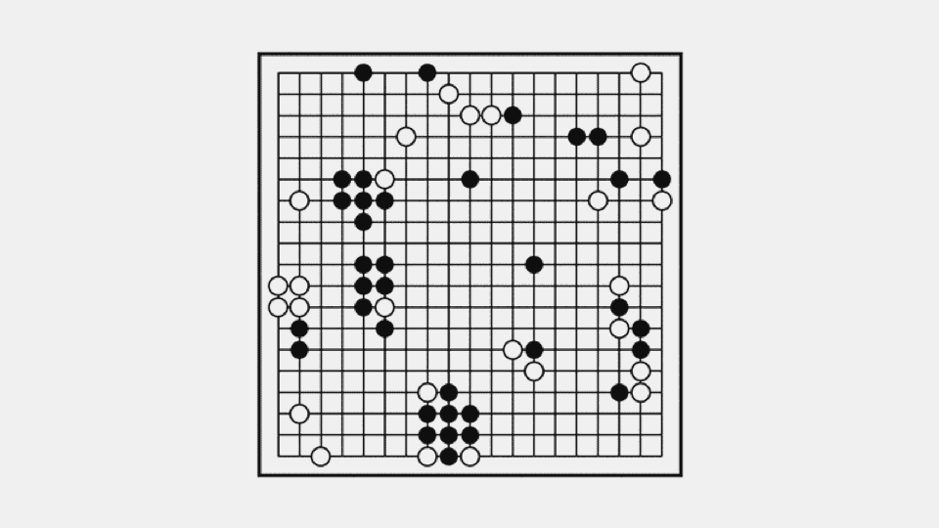
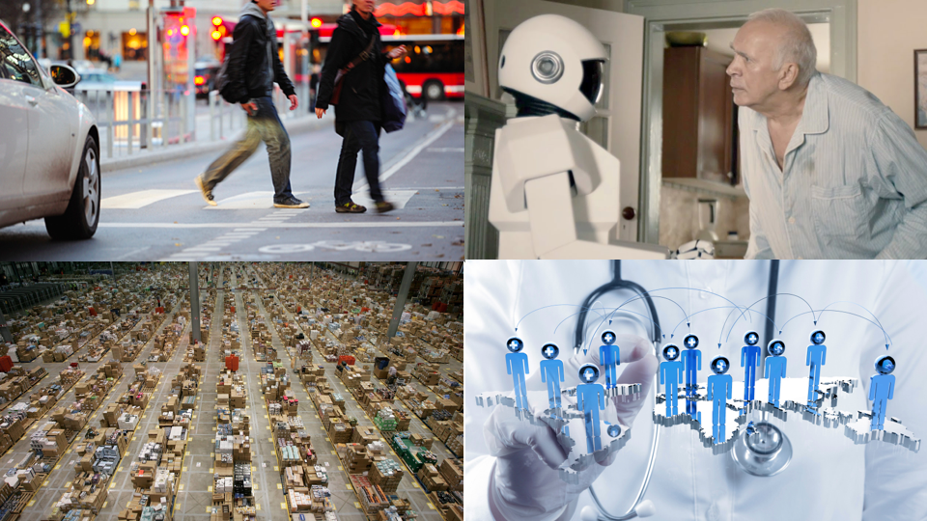
From AGI to AGI
simulation
short horizon
real world
extended timescale
fully observable
single agent
uncertainty
massively distributed
Slide Credit: Anca Dragan
Notes:
when a computer plays go, it's using a simulation -- it has perfect access to the state of board, it knows exactly what actions it can take, it knows exactly how these actions will change the state, it knows exactly what the objective is; real problems have none of these properties: it's unclear what the state space should be, you have to estimate it from sensor input, it's hard to define what the actions should even be let alone what the dynamics model is, and it's really really hard to write down the right objective -- you're dealing with real people, and your behavior will have real consequences. you also have to plan for extended time horizons and deal with multiple agents;

Slide 6
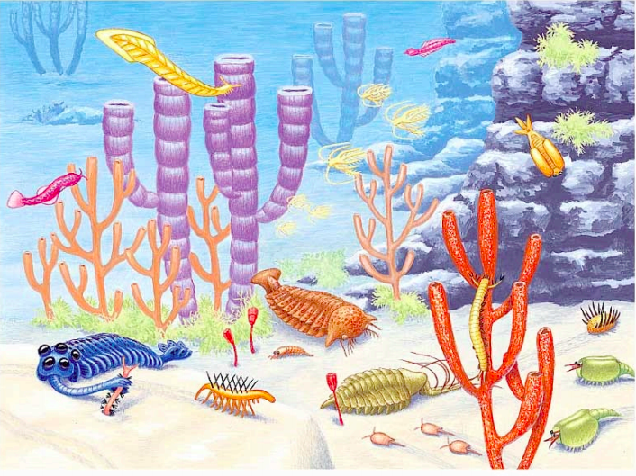
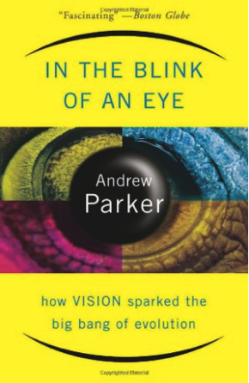
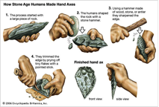
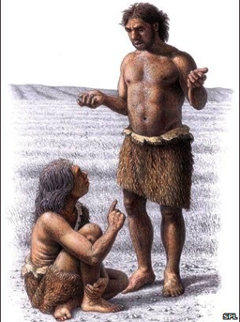
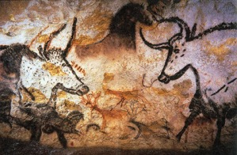
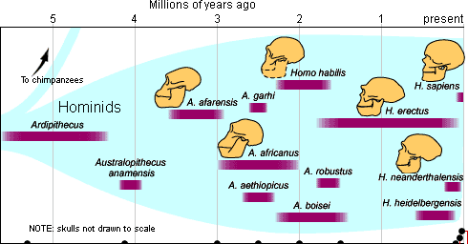
Phylogeny of Intelligence
Cambrian Explosion
540 million years ago
Variety of life forms,
almost all phyla emerge
Animals that could
see and move
Gibson: we see in order to move and we move in order to see
Modern humans, last 50 K years
Hominid evolution, last 5 million years
Bipedalism
Opposable thumb
Tool use
Language
Abstract thinking
Symbolic behavior
Anaxogaras: It is because of his being armed with
hands that man is the most intelligent animal

Slide 7
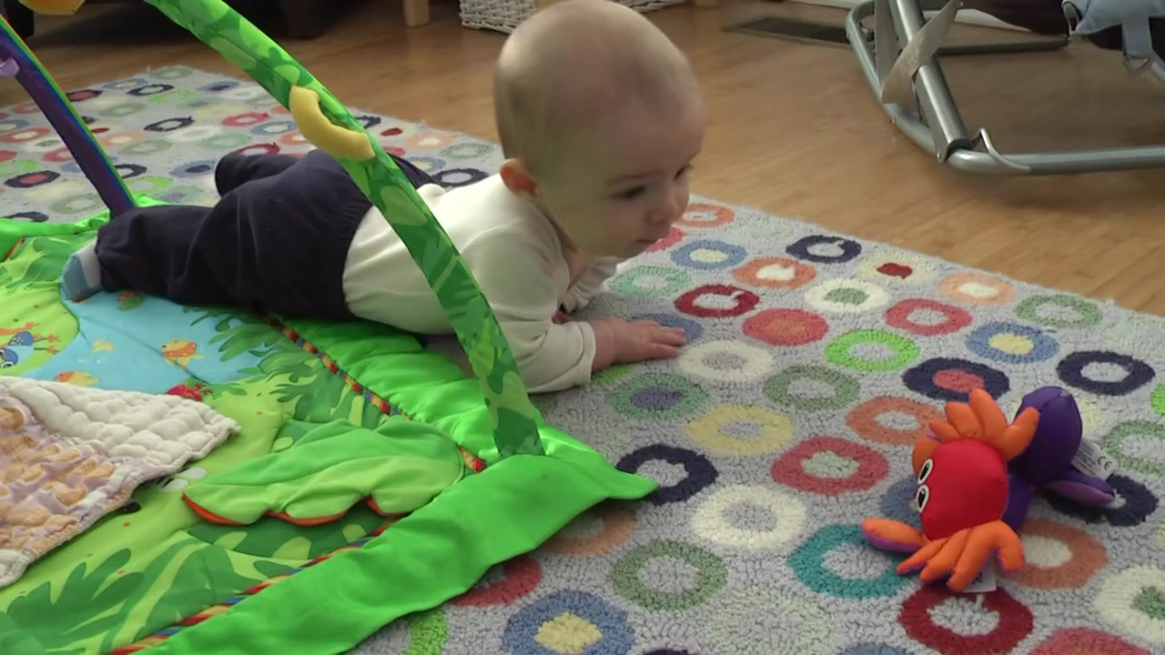
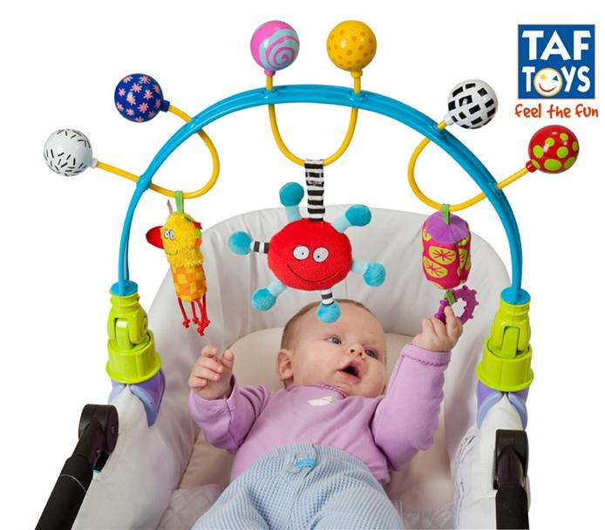
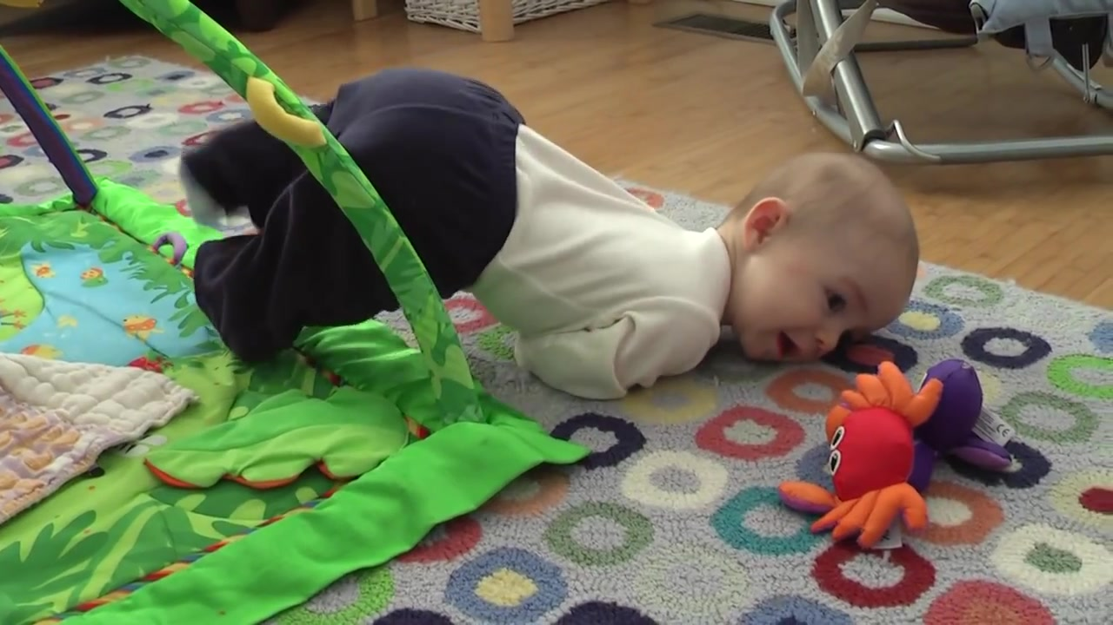
Consider infants,

Slide 8
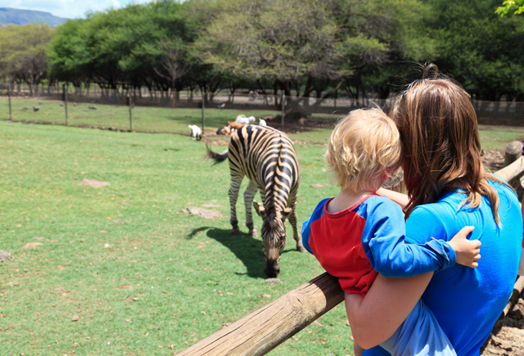
External Teacher Signal
External
Supervision
Internal
Teacher Signal
Self
Supervision

Slide 9
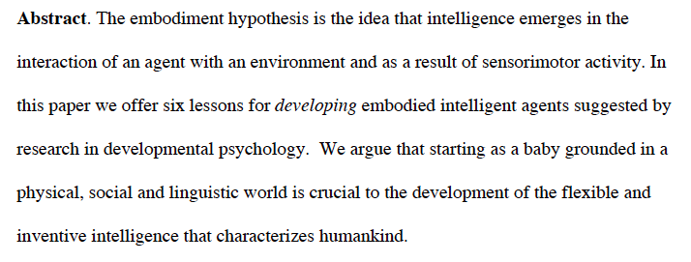
The Development of Embodied Cognition: Six Lessons from Babies Linda Smith & Michael Gasser

Slide 10
The Six Lessons
Be multi-modal
Be incremental
Be physical
Explore
Be social
Use language

Slide 11
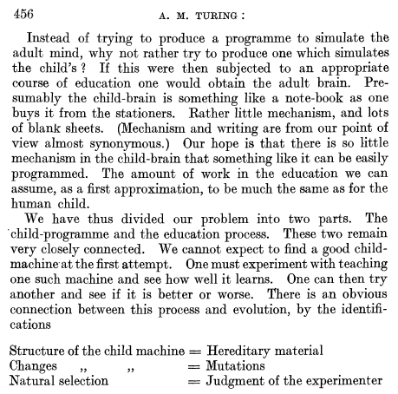
Computing Machinery and Intelligence Turing (1950)

Slide 12
Learning To Poke by Poking: Experiential Learning of Intuitive Physics
Pulkit Agrawal*, Ashvin Nair*, Pieter Abbeel, Jitendra Malik,
Sergey Levine
NIPS 2016
*Equal contribution

Slide 13
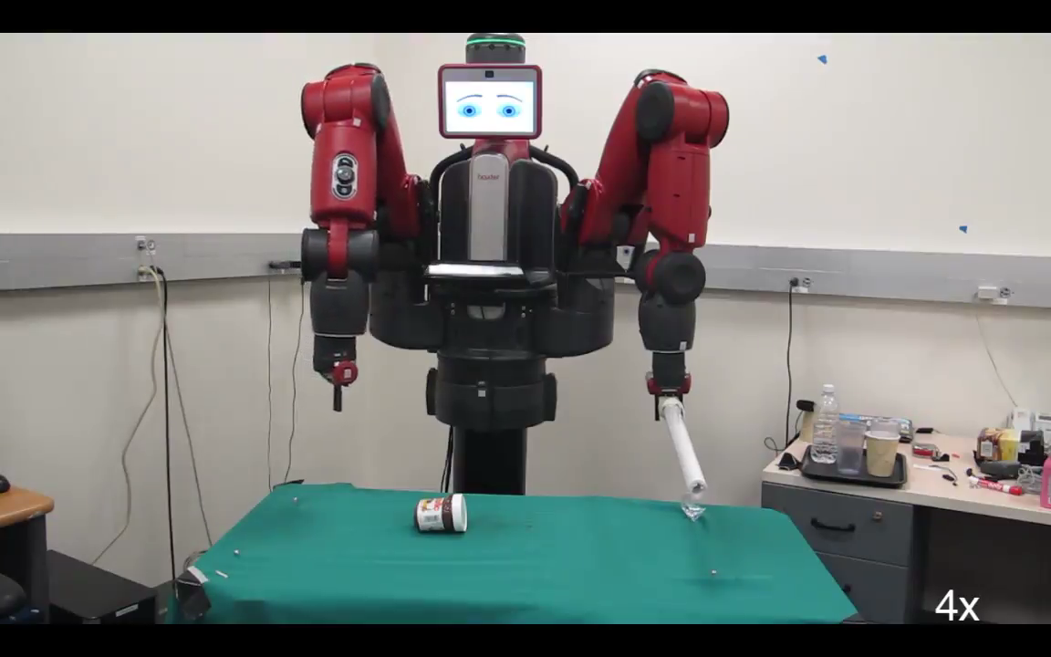

Slide 15
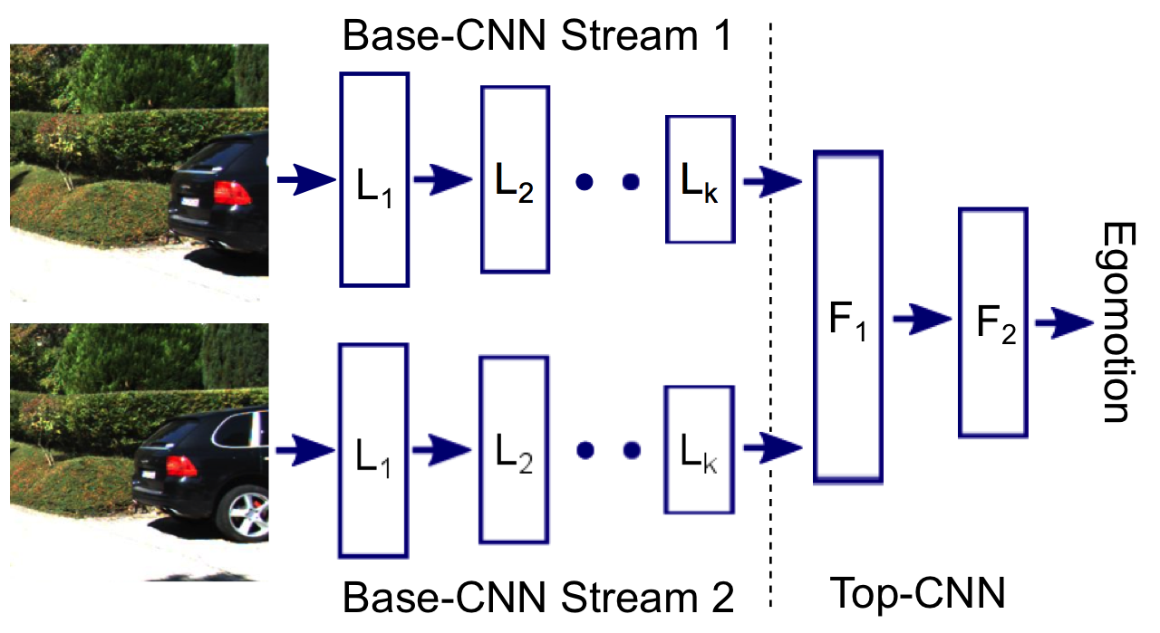
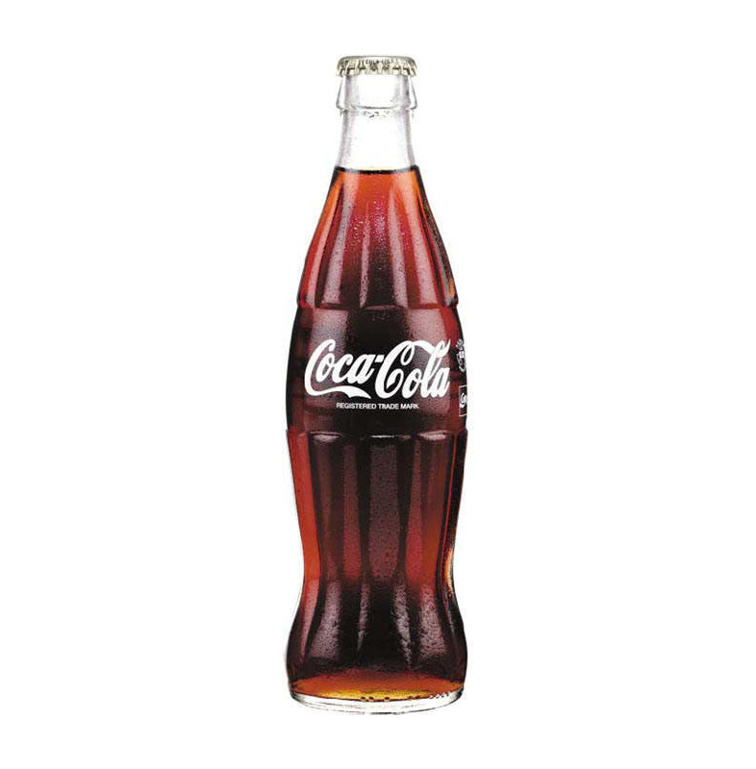

Forward Model
Inverse Model
Multimodality in output space
Predictor
Z_{t}
v_{t}
Z_{t+1}
Image Encoder
Action Encoder
Decoder
Image
(X_{t})
Action
(u_{t})
We donot want to predict pixels!!

Slide 16
Our Method: Jointly Learn Forward and Inverse Model
Forward model regularizes inverse model !!
Predictor
Z_{t}
v_{t}
Z_{t+1}
Simultaneously learn and predict in an abstract features space (Z_{t})
Image Encoder
Action Encoder
Image Encoder
Image
(X_{t})
Action
(u_{t})

Slide 17
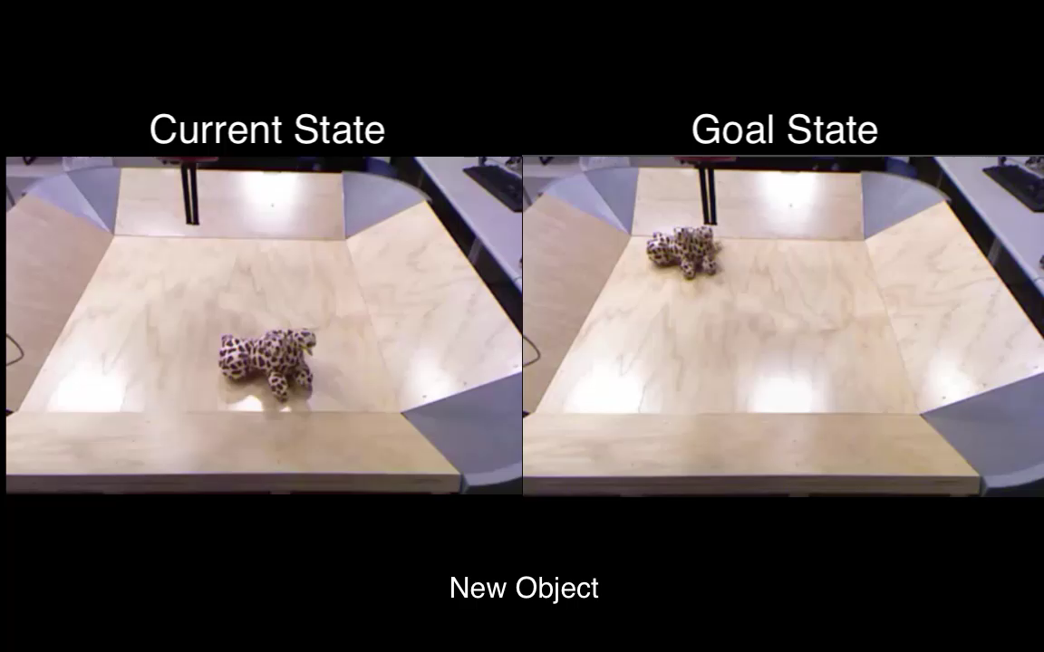
More Generalization
Notes:
Replace this video by one showing some success and failures on different objects and then have a slide with collage and then put the generalization video.

Slide 18


Combining self supervision with imitation for vision based rope manipulation
Ashvin
Dian
Ashvin Nair*, Dian Chen*, Pulkit Agrawal*,
Phillip Isola, Pieter Abbeel, Jitendra Malik, Sergey Levine
ICRA, 2017

Slide 19
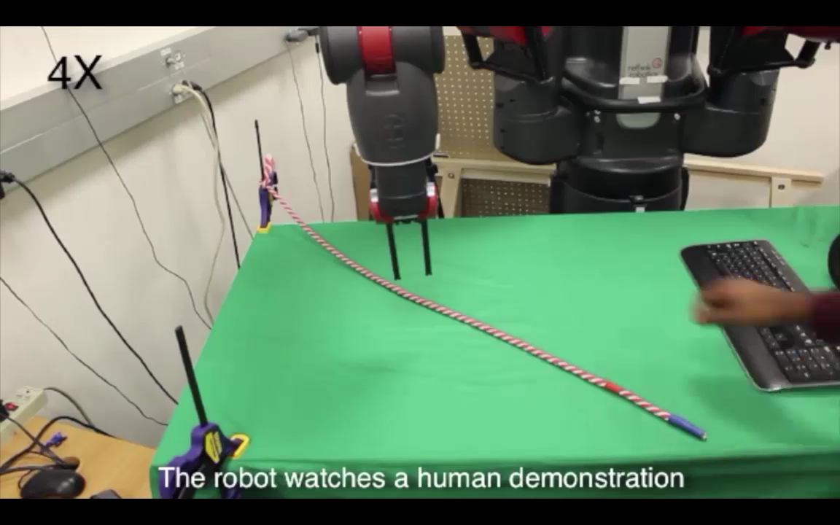
Results

Slide 20
Segmentation by Interaction: Setup
Pathak*, Shentu*, Chen*, Agrawal*, Levine, Darrell, Malik. In submission, 2018.

Slide 21
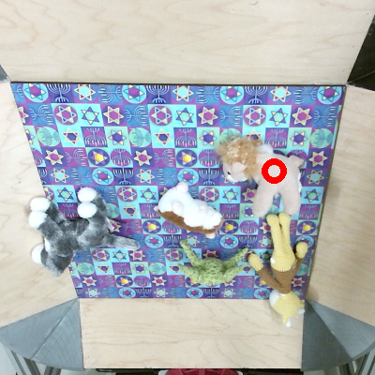
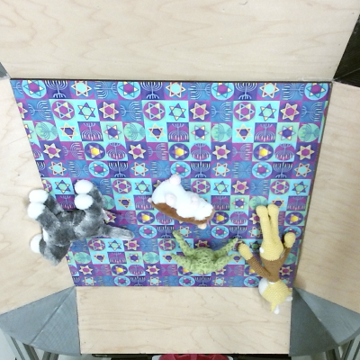

Segmentation hypothesis
Grasp at candidate locations
Image after interaction
Initial image
Learning Instance Segmentation By Interaction Pathak*, Shentu*, Chen*, Agrawal*, Levine, Darrell, Malik. In submission, 2018.

Slide 22
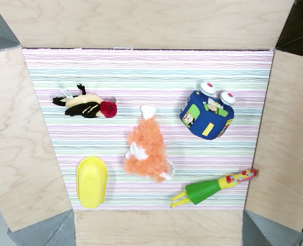
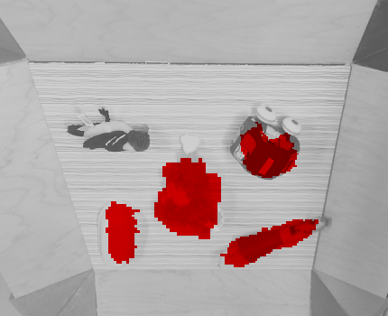
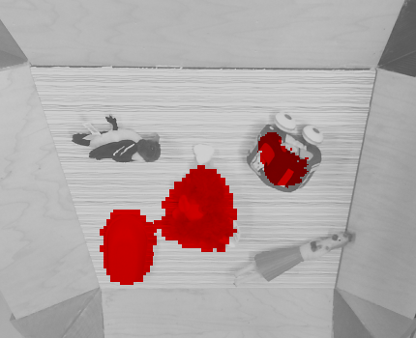
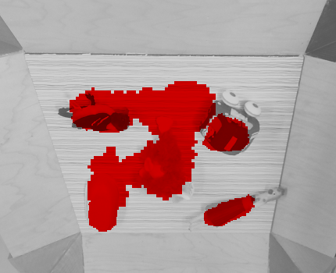
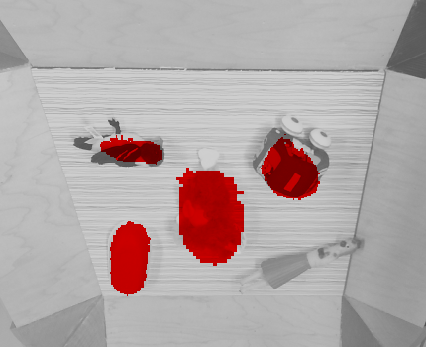
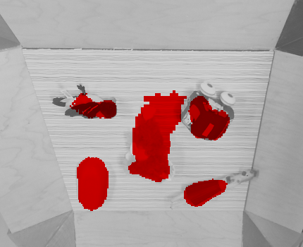
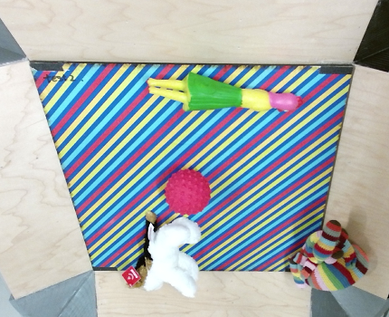
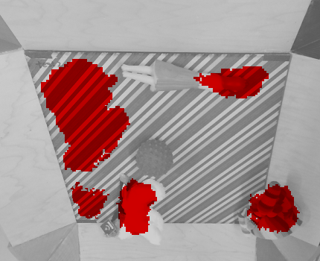
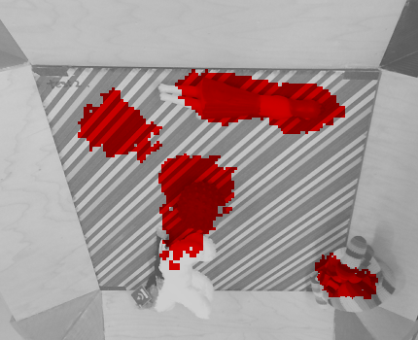
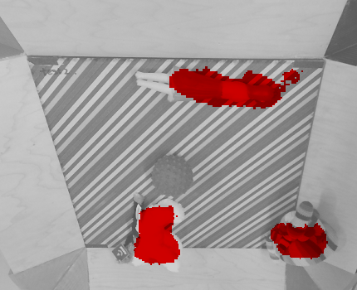
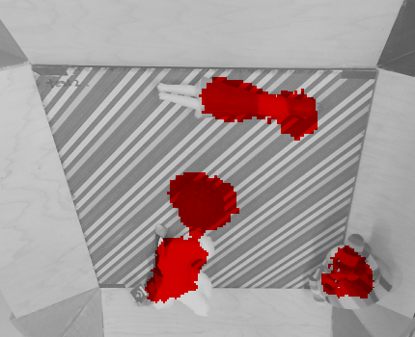
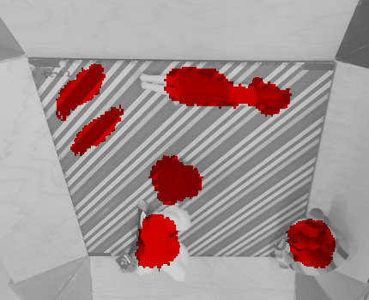
Instance Segmentation Performance
Pathak*, Shentu*, Chen*, Agrawal*, Levine, Darrell, Malik. In submission, 2018.

Slide 23
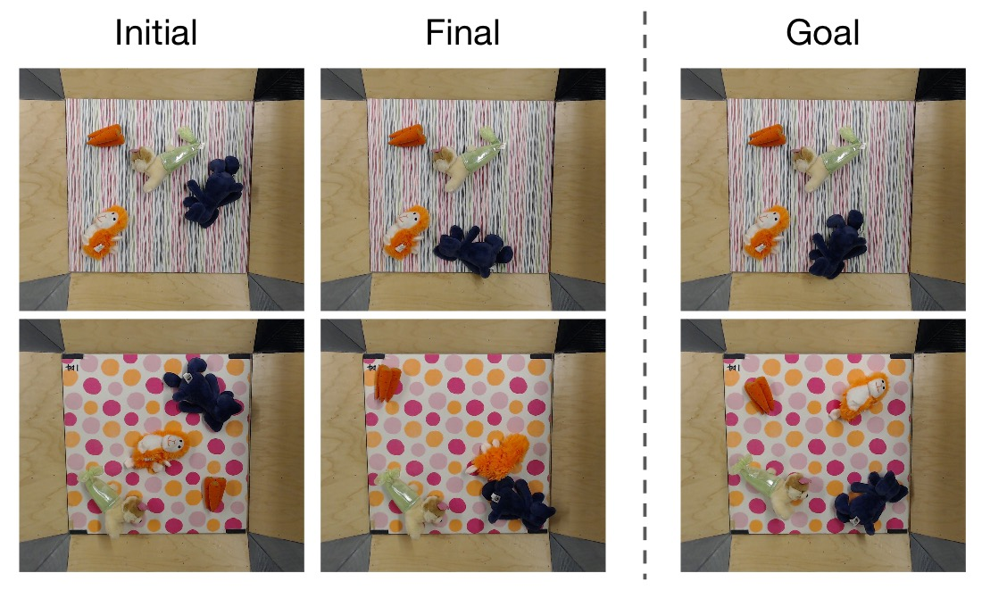
End task performance: Object Rearrangement
Pathak*, Shentu*, Chen*, Agrawal*, Levine, Darrell, Malik. In submission, 2018.

Slide 24
The Six Lessons
Be multi-modal
Be incremental
Be physical
Explore
Be social
Use language

Slide 25
Social Perception
Computers today have pitifully low “social intelligence”
We need to understand the internal state of humans as they interact with each other and the external world

Slide 26
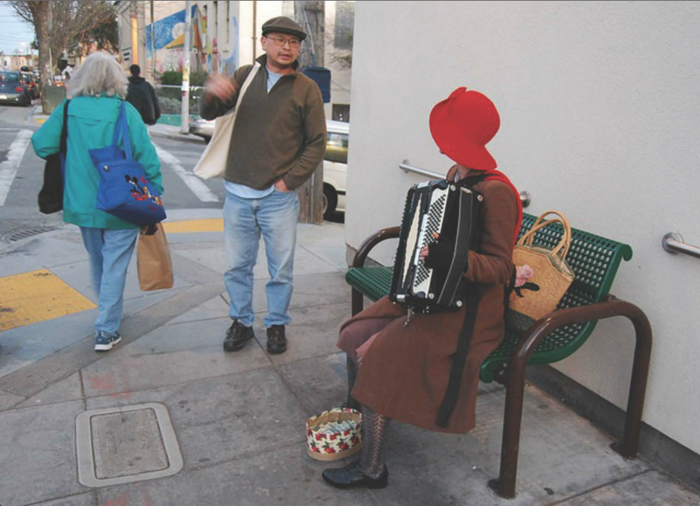

Slide 27
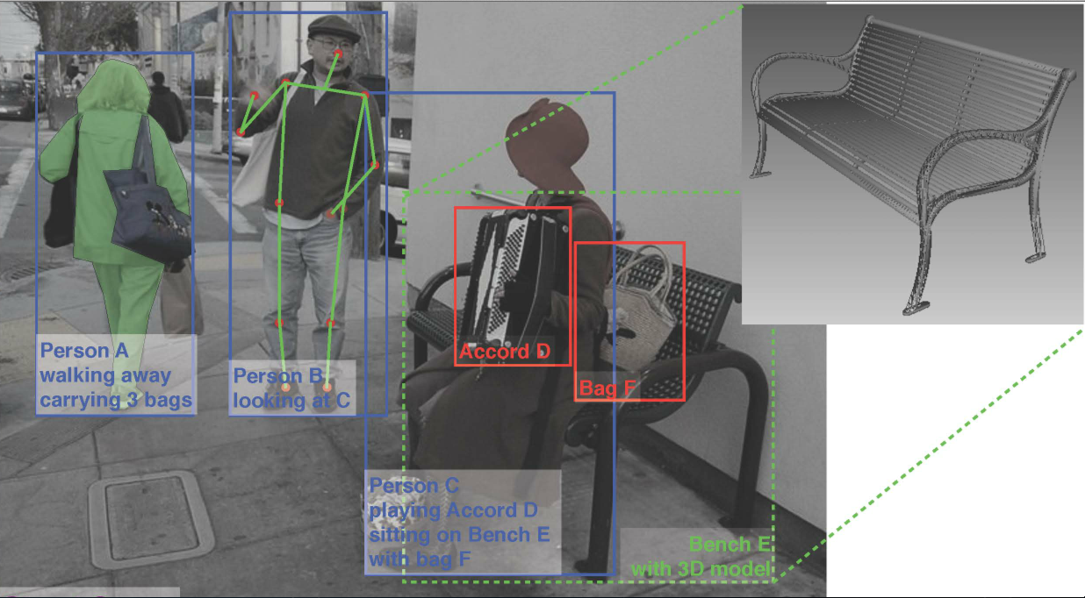
What we would like to infer…
Will person B put some money into Person C’s tip bag?

Slide 28
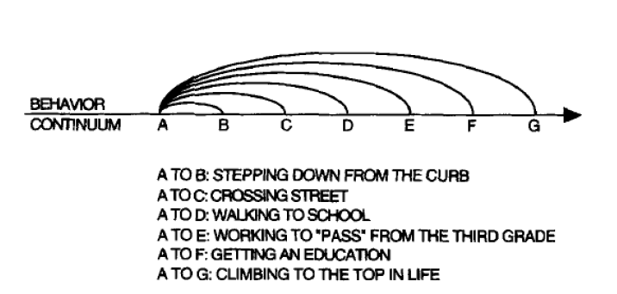
What we need to understand video
The hierarchical structure of human behavior- movement, goals, actions and events e.g. Barker and Wright (1954).

Slide 29
This is much harder than object detection
The hierarchical structure of human behavior- movement, goals, actions and events
Our datasets don’t capture this
ACTION = MOVEMENT + GOAL

Slide 30

Children can infer intent

Slide 31
Progress in video understanding
Much better datasets are needed. UCF 101 and HMDB have long outlived their usefulness. They do not represent “human behavior” either with respect to object manipulation or social interaction adequately
Two new datasets will be introduced at CVPR 2018
VLOG (Fouhey et al, UC Berkeley)
AVA (Gu et al, Google)

Slide 32
Commonsense Knowledge e.g. A meal at a restaurant
Classical AI/Cognitive Science Solution – Schemas (frames, scripts etc.)
To have a robust, visually grounded solution we need to learn these models from video
Models can be of physical behavior or social behavior.

Slide 33
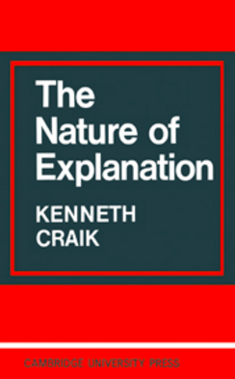
On Mental Models
If the organism carries a `small-scale model’ of external reality and of its own possible actions within its head, it is able to try out various alternatives, conclude which is the best of them, react to future situations before they arise, utilize the knowledge of past events in dealing with the present and the future, and in every way to react in a much fuller, safer, and more competent manner to the emergencies which face it (Craik, 1943,Ch. 5, p.61)
Modern Control theory (Kalman et al) uses a state
space formalism to achieve this.

Slide 34
The Six Lessons
Be multi-modal
Be incremental
Be physical
Explore
Be social
Use language

Slide 35
Phylogeny of Intelligence
Cambrian Explosion
540 million years ago
Variety of life forms,
almost all phyla emerge
Animals that could
see and move
Gibson: we see in order to move and we move in order to see
Modern humans, last 50 K years
Hominid evolution, last 5 million years
Bipedalism
Opposable thumb
Tool use
Language
Abstract thinking
Symbolic behavior
Anaxogaras: It is because of his being armed with
hands that man is the most intelligent animal

Slide 36
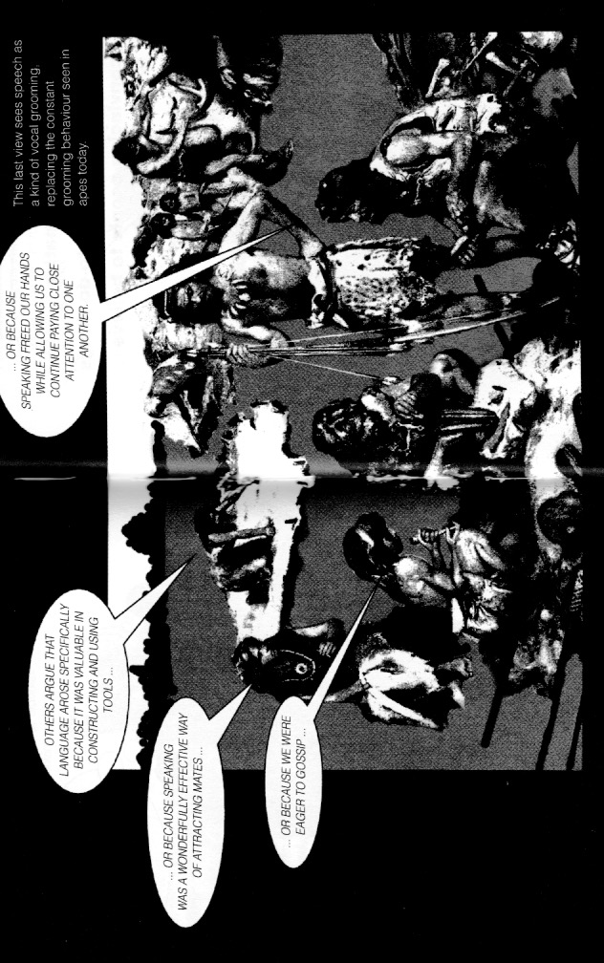
Origins of Language (from Trask)

Slide 37
The Purposes of Language (Source: R.L. Trask, Introducing Linguistics)
Passing on information
Persuading people to do things
Convincing people to believe things
Entertaining others
Amusing ourselves
Maintaining and displaying our place in society
Expressing our individuality
Expressing our emotions
Maintaining good (or bad) relations with others

Slide 38
Language research today
Great success on problems such as machine translation, but the techniques feel like simulations of Searle’s Chinese Room [see D. Hofstadter, Atlantic]
Grounding is essential, so I like work such as VQA
But much more is needed

Slide 39
Aspects of Language acquisition
Interaction and shared attention is crucial (Tomasello)
Bard & Sachs (1977)’s study of Jim, a hearing child of deaf parents
Real children develop language to fulfill their needs and interact with the environment. Static datasets may not be enough.

Slide 40
Gibson Environment
for Embodied Real-World Active Perception
Amir Zamir*, Fei Xia*, Jerry He*, Sasha Sax
Jitendra Malik, Silvio Savarese
CVPR 2018

Slide 41
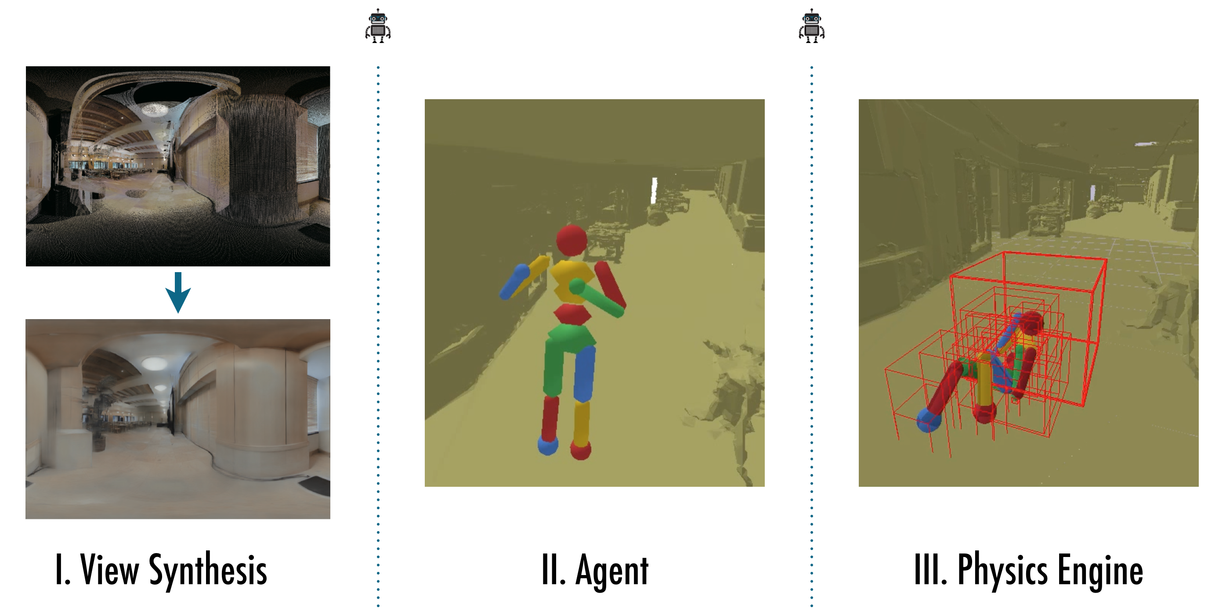
Components of Gibson

Slide 42
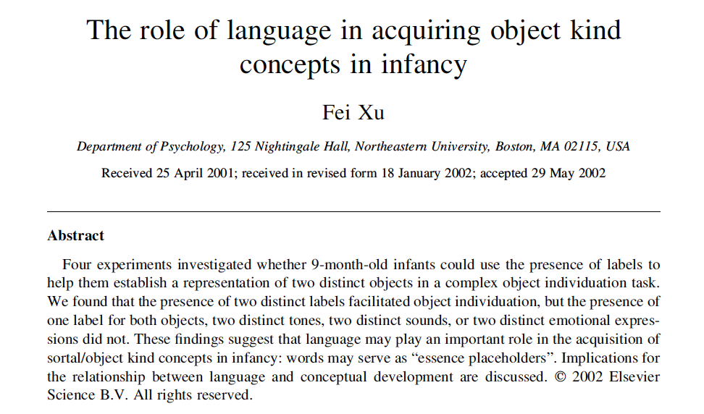
Language helps categorization

Slide 43
Embodied Cognition
Vision
(broadly,perception)
Motor Control
(broadly,planning)
Language
Semantic Reasoning

Slide 44
Some themes
Learning by Interaction
3D
Video Understanding
Visual Environments
Taskonomy

Slide 45
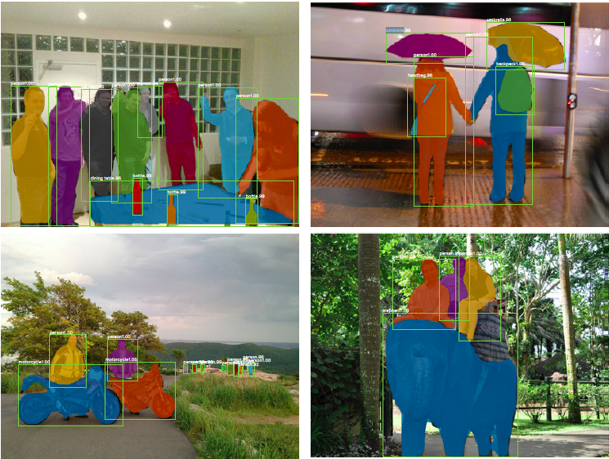
Mask R-CNN : He, Gkioxari, Dollar & Girshick (2017)

Slide 46
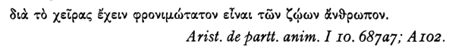
Hominid evolution in last 5 million years
Bipedalism freed the hand for tool making. Dexterous hands coevolved with larger brains.
Anaxagoras: It is because of his being armed with hands that man is the most intelligent animal

Slide 47
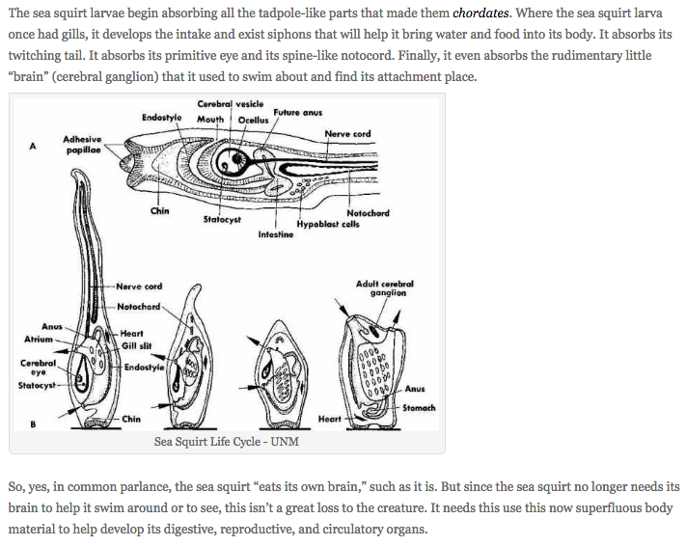
If you don’t need to move you don’t need an eye or a brain! https://goodheartextremescience.wordpress.com/2010/01/27/meet-the-creature-that-eats-its-own-brain/

Slide 48

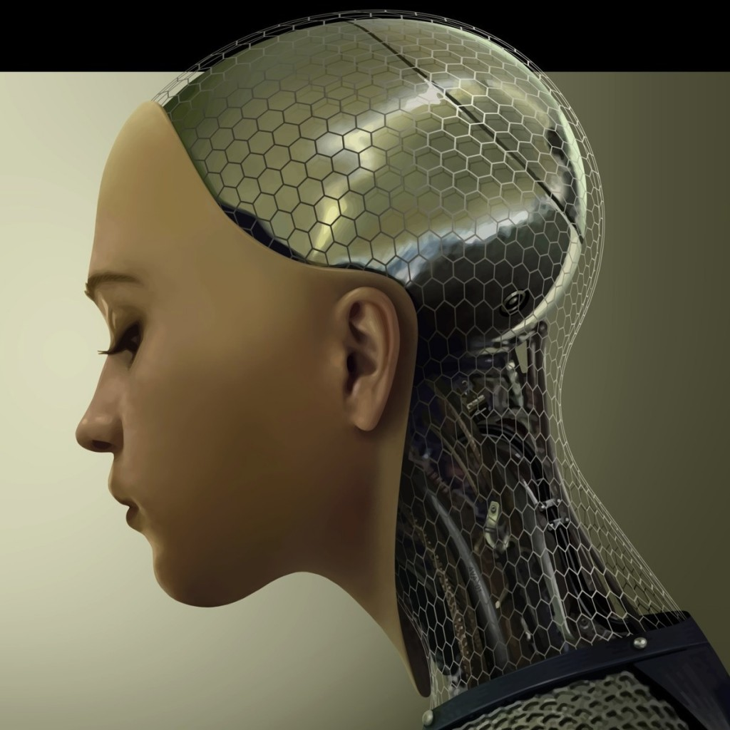
AVA: A Video Dataset of Atomic Visual Actions
Chunhui Gu, Chen Sun, David A. Ross, Caroline Pantofaru, Yeqing Li, Sudheendra Vijayanarasimhan, George Toderici, Susanna Ricco, Rahul Sukthankar, Cordelia Schmid, and Jitendra Malik
Google Research

Slide 49
run/jog
walk
jump
stand
sit
lie/sleep
bend/bow crawl
swim
dance
get up
fall down
crouch/kneel
martial art
open
close
enter
exit
lift/pick up
put down
carry
hold
throw
catch
eat
drink
cut
hit
stir
press
extract
read
write
smoke
sail boat
row boat
fishing
touch
cook
kick
paint
dig
shovel
chop
shoot
take a photo
brush teeth
clink glass
work on a computer
answer phone
climb (e.g., mountain)
play board game
play with pets
drive (e.g., a car)
push (an object)
pull (an object)
point to (an object)
play musical instrument
text on/look at a cellphone
turn (e.g., screwdriver)
dress / put on clothing
ride (e.g., bike, car, horse)
watch (e.g., TV)
talk to
watch
listen to
sing to
kiss
hug
grab
lift
kick
give/serve … to …
take … from …
play with kids
hand shake
hand clap
hand wave
fight/hit
push

Slide 50

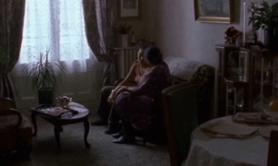
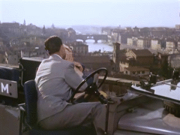
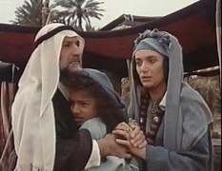
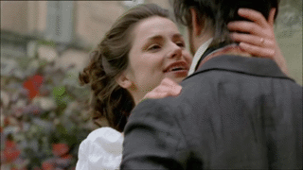

Hug (a person)

Slide 51
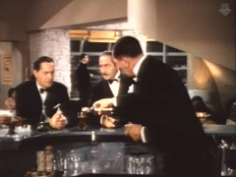




Give/Serve (an object) to (a person)

Slide 52
Hockett’s list of design features for a human language
Vocal-Auditory Channel: Much of human language is performed using the vocal tract and auditory channel. Hockett viewed this as an advantage for human primates because it allowed for the ability to participate in other activities while simultaneously communicating through spoken language.
Broadcast transmission and directional reception: All human language can be heard if it is within range of another person’s auditory channel. Additionally, a listener has the ability to determine the source of a sound by binaural direction finding.
Rapid Fading (transitoriness): Wave forms of human language dissipate over time and do not persist. A hearer can only receive specific auditory information at the time it is spoken.
Interchangeability: A person has the ability to speak and hear the same signal. Anything that a person is able to hear can be reproduced in spoken language.
Total Feedback: Speakers can hear themselves speak and monitor their speech production and internalize what they are producing by language.
Specialization: Human language sounds are specialized for communication. When dogs pant it is to cool themselves off. When humans speak, it is to transmit information.
Semanticity: Specific signals can be matched with a specific meaning.
Arbitrariness: There is no limitation to what can be communicated about and no specific or necessary connection between the sounds used and the message being sent.
Discreteness: Phonemes can be placed in distinct categories which differentiate them from one another, like the distinct sound of /p/ versus /b/.
Displacement: People can refer to things in space and time and communicate about things that are not present.
Productivity: People can create new and unique meanings of utterances from previously existing utterances and sounds.
Traditional Transmission: Human language is not completely innate, and acquisition depends in part on the learning of a language.
Duality of patterning: Meaningless phonic segments (phonemes) are combined to make meaningful words, which, in turn, are combined again to make sentences.

Slide 53
From AGI to AGI
simulation
short horizon
real world
extended timescale
fully observable
single agent
uncertainty
massively distributed
Notes:
when a computer plays go, it's using a simulation -- it has perfect access to the state of board, it knows exactly what actions it can take, it knows exactly how these actions will change the state, it knows exactly what the objective is; real problems have none of these properties: it's unclear what the state space should be, you have to estimate it from sensor input, it's hard to define what the actions should even be let alone what the dynamics model is, and it's really really hard to write down the right objective -- you're dealing with real people, and your behavior will have real consequences. you also have to plan for extended time horizons and deal with multiple agents;

Slide 54





Ontogeny of Intelligence
Perception and Interaction
Language
Turing (1950)
Computing Machinery
And Intelligence

Slide 55
Taskonomy:
Disentangling Task Transfer Learning
Amir Zamir, Sasha Sax, William Shen, Leonidas Guibas, Jitendra Malik, Silvio Savarese
CVPR 2018

